Slide 1
free swimming

Slide 3

FM sound

Slide 4
gap

Slide 5
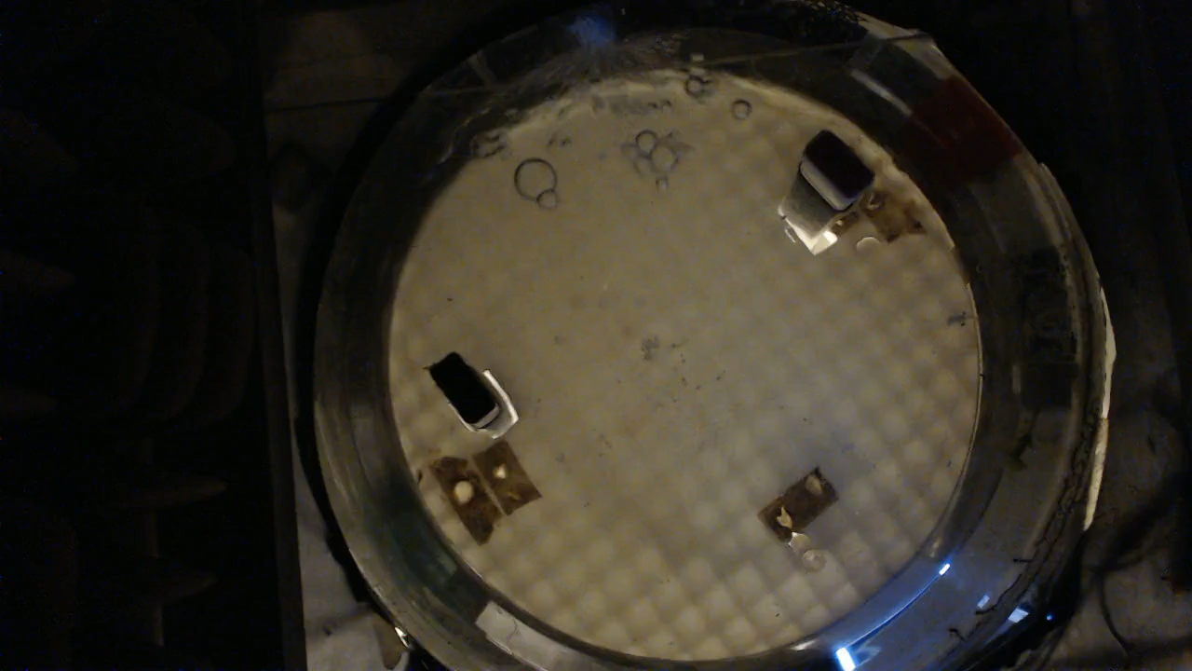
social reward

Slide 6
break

Slide 9
gap

Slide 11
break

Slide 13
CF sound

Slide 14
gap

Slide 15
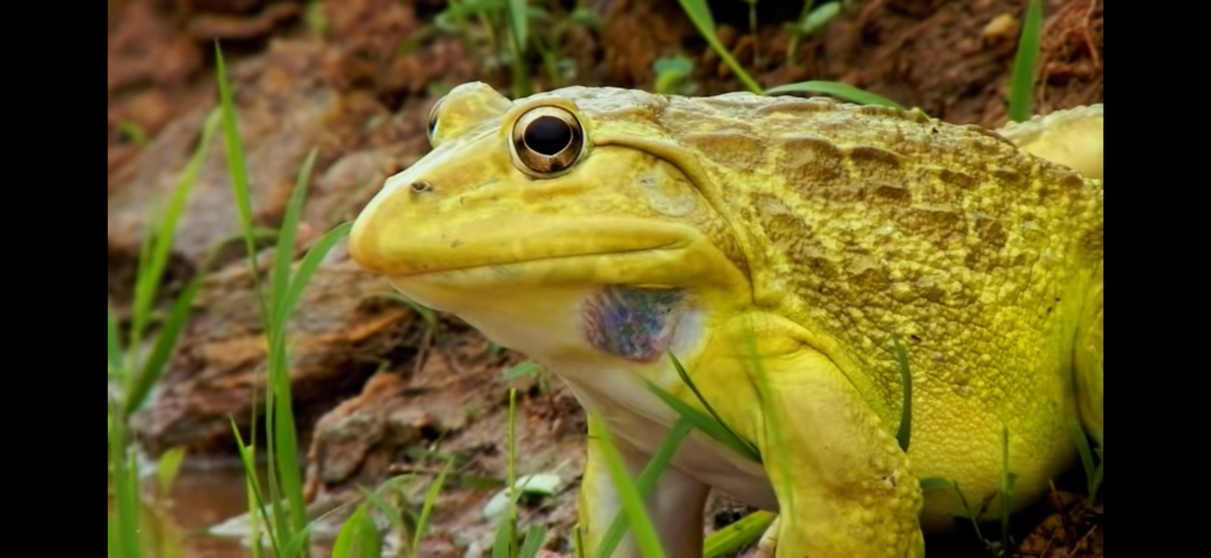

Slide 16
break

